Slide 1
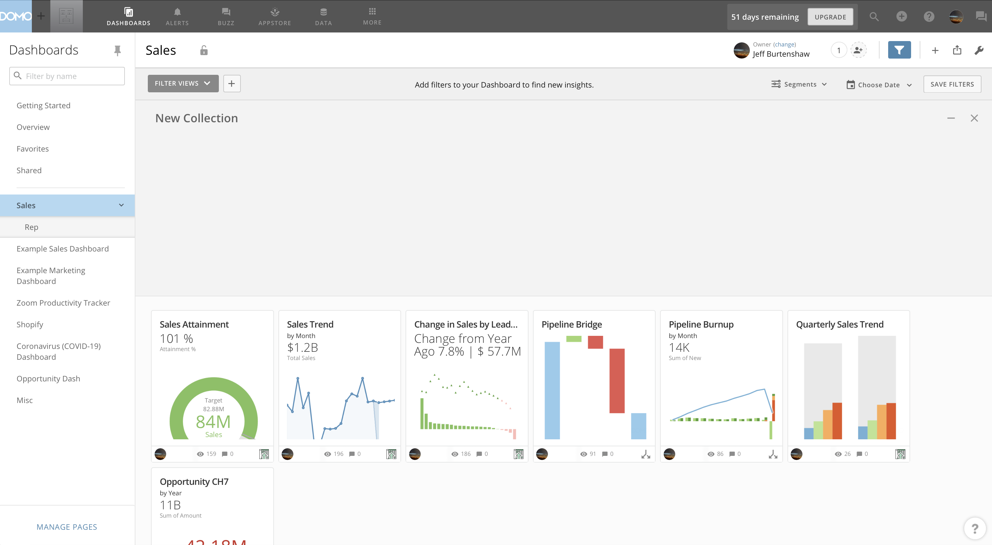
Apply Saved Filter
Add Filter Fields
Hide/Show Filter Bar
Add Collection
Change Filter Options
Save Filter Settings
Page Date Filter
Delete Collection
Hide/Show Collection

Slide 2
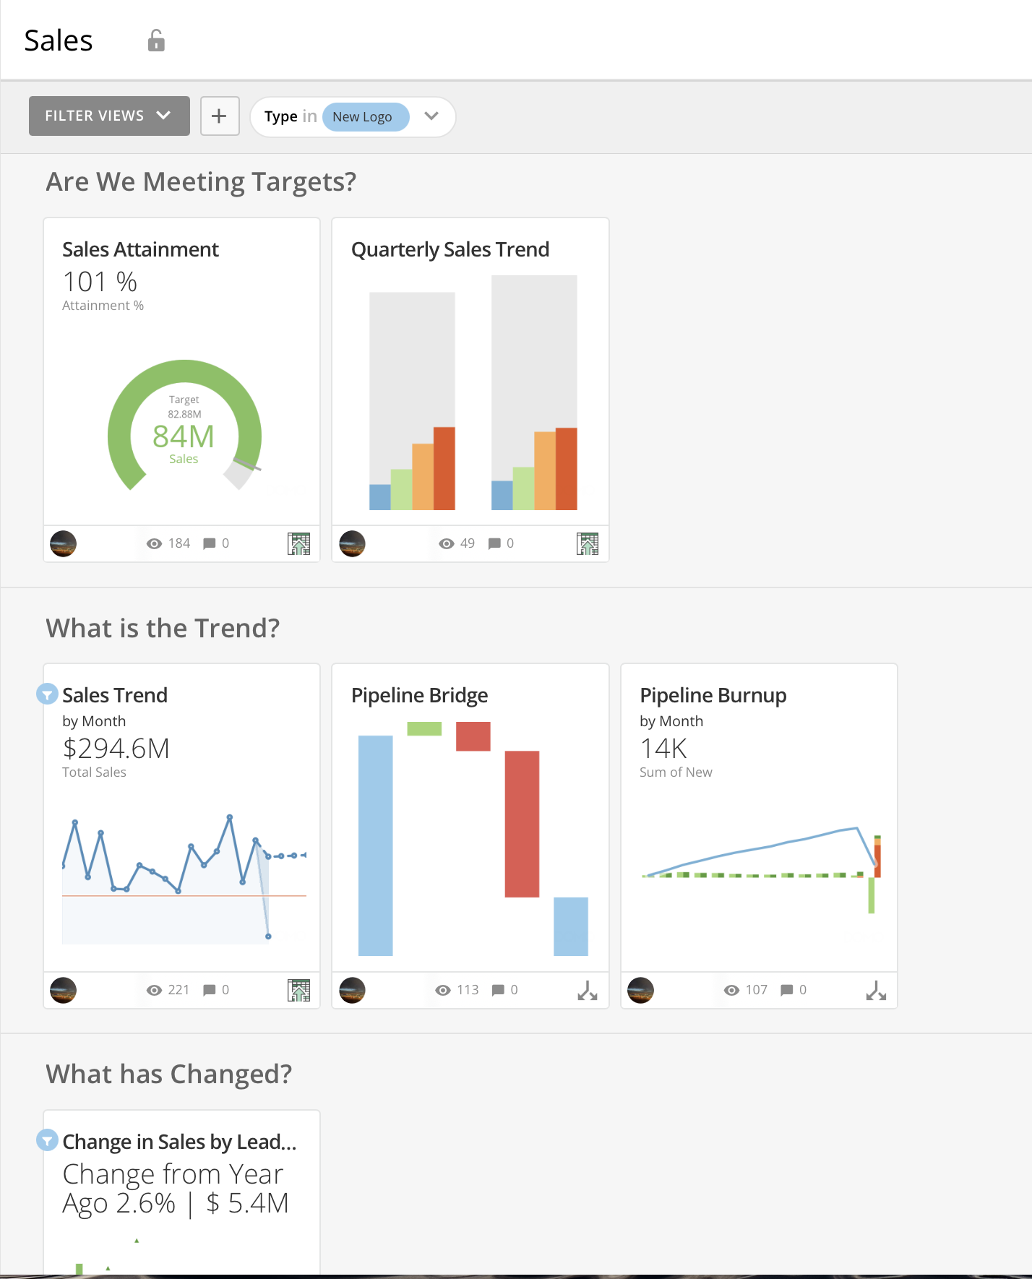
Filtered Card Indicator

Slide 3
